Slide 1


Slide 2

K-means Clustering

Slide 3

Unsupervised Learning
We know that unsupervised learning basically implies no “target”.
But if we are not predicting something, what are we doing?
Further, if there is no target, is their an error? How do have any sense of “right” or “wrong”?
Let’s understand with the help of conditional expecations.

Slide 4
Supervised vs. Unsupervised
In supervised learning, we want Prob.(Y|X) .
Here, the Pr(X) is the joint marginal density of the X values alone.
While in supervised learning this is seldom our concern, in the absence of a Y, this is all we have.
So formally speaking in unsupervised learning, the goal is to directly infer the properties of this probability density without the help of a supervisor or teacher providing correct answers or degree-of-error for each observation.

Slide 5
Unsupervised Learning
In less formal terms, our goal in supervised learning is to summarize or find some interesting properties about our dataset.
And you know what, we have encountered this thinking before
In PCA, we did not use the target and instead used X to find axes of max. variance.
In a sense, we were summarizing the dataset in a lower-dimensional space.

Slide 6
Cluster Analysis
Another form of unsupervised learning is cluster analysis.
Here we seek to group or segment a collection of objects into subsets or “clusters,” such that those within each cluster are more closely related to one another than objects assigned to different clusters.
Today, we will look at one type of clustering. K-means clustering.

Slide 7

K-means Clustering
In K-means, we are seeking K homogeneous clusters or sub-groups among our observations.
Perhaps we are seeking customer types in ecommerce data.
First, however, we need to declare a measure of similarity/dissimilarity.
One measure is simple euclidean distance [a la KNN]. Specifically, our goal is to minimize the distance between observations of one cluster or Within Cluster variation

Slide 8

K-means Clustering
W(C_{k}) is our cost function expressed as:
This states that within cluster variation is the average sum of squared distances across all observations of each variable . The average is given by dividing across the no. of observations for the Kth Cluster. So we seek to minimize this across all K cluster.

Slide 9
K-means Clustering
Here is the algorithm to perform the minimization:
Choose a number of clusters (K) and randomly assign each row observation a clustering between 0 and K (inclusive)
For each cluster compute the centroid → centroid is the vector of p feature means for a p-dim dataset. Each feature mean is given by averaging the observations for the pth feature.
Now re-assign each row-observation to the cluster whose pth feature mean is closest to it.
Iterate until the cluster assignment stops changing or the W(C_{k})
cost function across cluster is within a tolerable range.

Slide 10
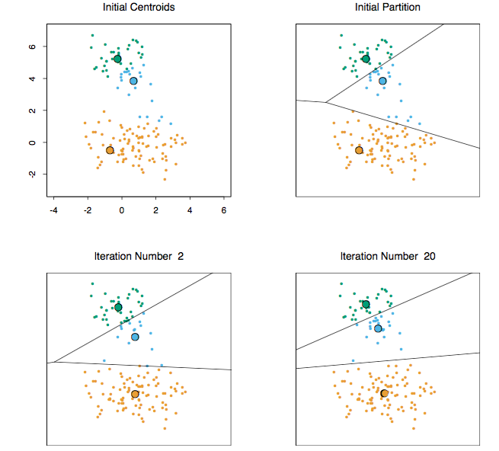
Clusters change during iteration

Slide 11
How to Identify our “best” cluster?
We must choose the value of K the best segments the data. Values of K can range from 1 to N.
However, as the value of K gets larger the cost function will naturally decrease as each cluster would be very tight.
One method to choose K is to plot various values of K against the cost function/average distance and stop when delta[W(C_{k}), W(C_{k+!})] stops increasing.
That is, when adding a new cluster reduces the cost function less than the addition of the previous cluster.
This is called the “Elbow” Method, as we choose the value of K at the elbow of the function

Slide 12
Sillhouette Method
In Sillhouette analysis our goal is to inspect the distance between each observation in one cluster to its nearest cluster.
The resultant object of analyses is the sillhouette coefficient which is a ratio of distance between a point and the next cluster and the within cluster variance of the observation in question.
Coeff = b - a
max(a,b)
For more go to http://scikit-learn.org/stable/auto_examples/cluster/plot_kmeans_silhouette_analysis.html

Slide 13
Sillhouette Method
Silhouette coefficients near +1 indicate that the sample is far away from the neighboring clusters. A value of 0 indicates that the sample is on or very close to the decision boundary between two neighboring clusters and negative values indicate that those samples might have been assigned to the wrong cluster.

Slide 14
Practical Tips on Usage
K means clustering is very suseptible to scaling. Let’s consider the example of ecommerce transactions for some company.
We have data for socks and laptops sold and are trying to generate customer cluster from this data.
Since a single buy many socks and few if no laptops per year, we expect the number of socks bought across different customers to drive similarity.
However if we apply a standard scaler to the data two customer who buy a single laptop per year will be though to be similar.
A third choice of scale is total $ spent per customer.
Ultimately the choice of scale is a bussiness decision!

Slide 15
